Slide 1
Life course approach for exploring the impact of sanitation access and menstrual hygiene management on psychosocial stress, behavior, and health among girls and women in Odisha (Orissa), India
Emory
Robert Dreibelbis
Matt C. Freeman
Kelly K. Baker
AIPH
Bhabani S. Das
Ambarish Dutta
Bijay K Padhi
Padmalaya Das
Krushna C Sahoo
PR Misra
LSHTM
Belen Torondel
UNMC
Pinaki Panigrahi
International Sanitation and Gender Workshop
Park Hotel, New Delhi, India
9-10 December 2013

Slide 2
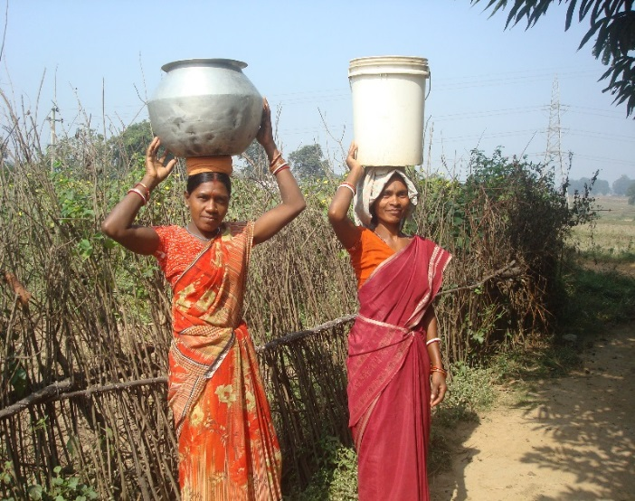
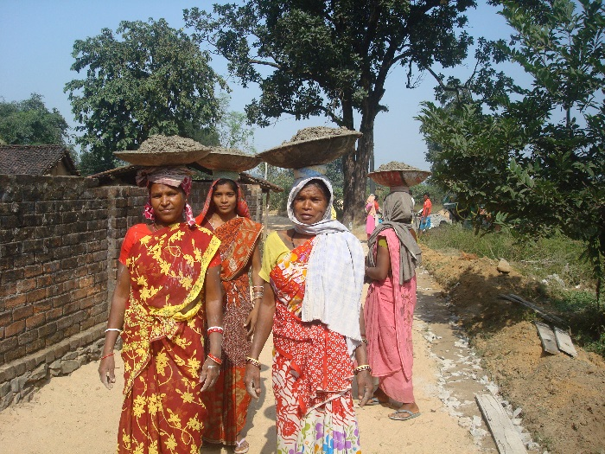
Gender, Sanitation, and Health in Odisha
In Odisha over 88% of rural population do not have adequate sanitation facilities (Govt. of Odisha Annual Plan 2011-12)
Odisha lags far behind in terms of access to toilet facilities and safe drinking water.
Between 2001–2010 sanitation coverage increased from 8% to 42%, but sustained toilet usage, and adoption of best hygiene practices remain key challenges.
Girls and women can experience gender-specific challenges in using available sanitation services.
May be particularly susceptible to hygiene-related diseases caused by decreased sanitation use.

Slide 3
Conceptual Model of Sanitation Access on Behavior and Health in girls and women
EXPOSURES
OUTCOMES
RA1
PSYCHOSOCIAL STRESS
Sanitation Access (Household and Community)
MHM
USE IN PREGNANCY
UROGENITAL INFECTIONS
RA2
RA3
PRETERM BIRTH

Slide 4
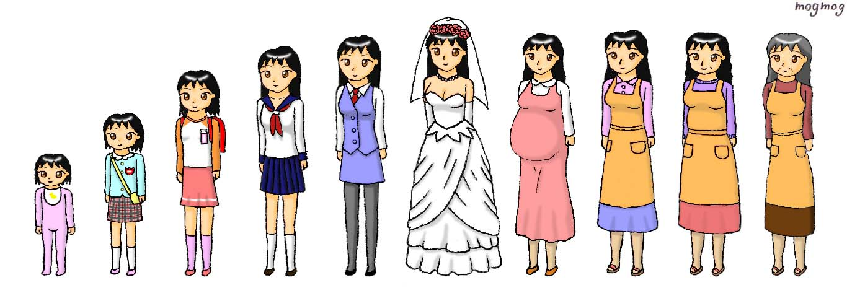
Female Life Course
Menarche: 14 years
(12-16)
Menopause: 47 years
(40-48)
http://gomyugomyu.deviantart.com/art/From-Cradle-to-Grave-176209118
~33 years
1716 days for defecation/urination
370 menstrual cycles
2.7 births (1 wealthiest – 8 poorest)

Slide 5
Interconnected study design
CROSS-SECTIONAL
STATISTICS (4000 HH):
Life course stage
Socio Economic Status
WASH access and use
MHM practices
Stress responses
2 week reported UTI/BV
Symptomology
HUAS for UTI/BV
POPULATION SURVEY
Adolescence:
13 – 18 yrs
Not married
Newly married:
Within one year,
Lives with in-laws
Married or previously married
Pregnant
MENSTRUATING
Notes:
Primary goals are to use an experience-centric framework to record how sanitation access is internalized by women and girls, how those stresses modify behaviors, and whether those hygiene behaviors have subsequent health consequences. Our longer term goals are to lay this information over baseline quantitative data to estimate the proportion of each at-risk population vulnerable to stress and adverse health consequences, report how likely these diseases are measured and treated within the Indian medical context, and finally propose a conceptual model estimating the cumulative impact of poor sanitation access on stress and health over a woman’s complete reproductive life cycle.

Slide 6
Sub-Study I: Sanitation-related Psychosocial Stress (SRPS)
SRPS and its associated health risks and social/behavioral adaptations not fully understood
Broader literature on water, sanitation, and hygiene (WASH) suggest that there is a strong link between WASH access and mental health outcomes
Dynamic in nature
Temporal: daily stresses, periodic stresses (menstruation, pregnancy), long-term (incontinence)
Life course: onset of menses, marriage and relocation into in-law’s home, pregnancy, child-rearing

Slide 7
PSYCHOSOCIAL STRESS
1)
2)
How is SRPS experienced by women at different stages of life?
How does withholding food /liquid, withholding defecation /urination, menses, fear of sexual and/or physical violence contribute to SRPS?
3)
How does SRPS influence sanitation-related behaviors and what are the potential health risks of these adaptive behaviors?

Slide 8
PSYCHOSOCIAL STRESS
Exploratory, mixed-methods design in which unstructured qualitative research leads to instrument development for SRPS
Stratified by life-stage and geographic location

Slide 9
Sub-Study II:
MHM association with health outcomes
Background:
Systematic Review (Sumpter and Torondel 2013):
1. Evidence for the impact of menstrual hygiene management (MHM) on Health outcomes was found in 13 articles.
2. Plausible association: good MHM and reduction of RTI.
Unclear about:
-Specific infections
-Strength of effect
-Route of transmission
- Role of water and sanitation access
-Definition of “good menstrual hygiene management”
Relevance in India: Between 43 and 88% of girls wash and reuse cotton clothes. Prevalence of UTI range (25-60%) and BV (15-25%).

Slide 10
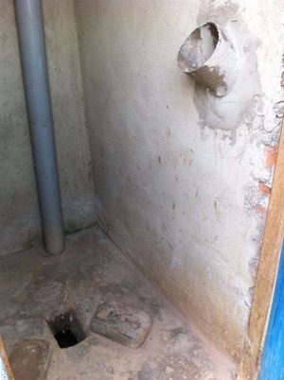
Research Aim:
Menstrual hygiene Management
(absorbent type, WASH conditions)
Health outcomes:
Bacterial Vaginosis
Urinary tract Infections
Are menstrual hygiene management practices (including type of absorbent used, pad hygiene practices and women WASH practices) risk factors for bacterial vaginosis and urinary tract infections?
Are menstrual hygiene practices associated with increased microbial contamination in menstrual absorbent pads?

Slide 11
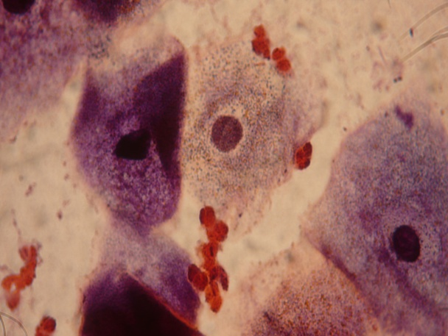
Study design: Case-Control hospital based study
-Number of women: 500
-Location: 2 hospitals (Bhubaneswar and Rourkela) Odisha
-Inclusion criteria: Women attending to gynaecology clinic,
18-45 years old
Non-Pregnant
Non menstruating during clinic visit
Cases: Women with one or more of the following symptoms:
Abnormal vaginal discharge
Burning or itching in the genitalia
Burning or itching when urinating.
Controls: Women with none of the above symptoms
-Risk factor assessment: Questionnaire
QA/QC: Exit interview
-Disease assessment: Laboratory diagnostic:
BV: Amsel/Nugent criteria and
UTI: culture microbiology test.
QA/QC: Examination of slides for Clue cell by an independent evaluator in 10% slides

Slide 12
Sub-Study III: WASH Access, Use, and Preterm Birth
Design: Observational prospective cohort study.
Setting: Rural (Balianta & Balipatana) and Tribal (Kuanrmunda and Lathikata) in Odisha, India.
Participants: All eligible pregnant women (18-45 aged).
Main Exposures: WASH practices and if any changes occurs during the course of pregnancy
Outcome Measures: Adverse pregnancy outcomes (LBW-<2500g, PTB-<37 weeks of gestation).

Slide 13
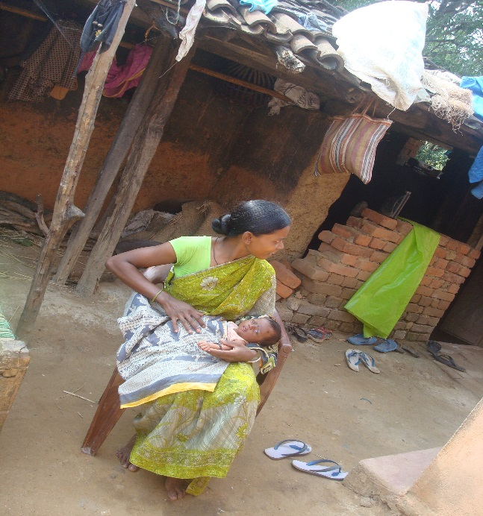
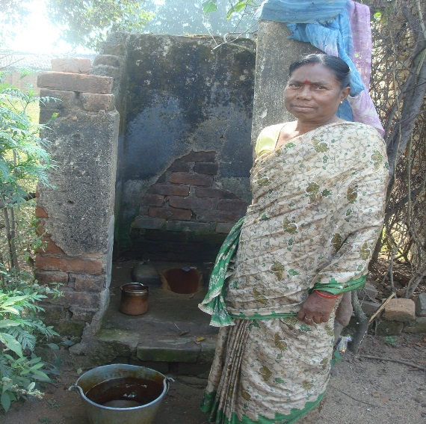
Time Frame of Follow-ups
12-15 Weeks:
First visit
Consent obtain
32-33 Weeks:
Third Visit
Eligible Pregnant enrolled for follow-ups using questionnaire
Birth Outcomes
23-24 Weeks:
Second visit
35-36 Weeks:
Fourth Visit

Slide 14
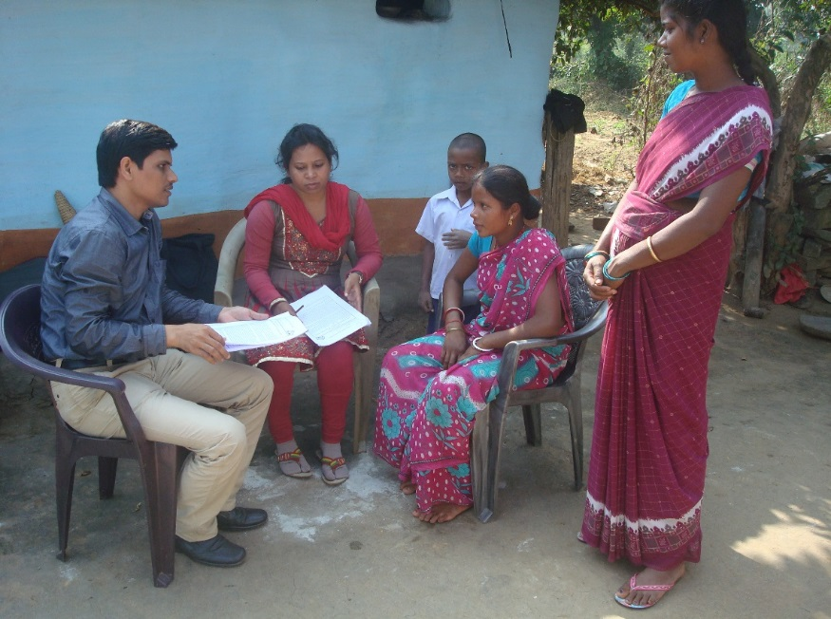
Human Resources Engaged in the Study
Project Investigator (s)
(Bijay, Pinaki, Kelly)
Project Manager
(Bibhu)
Area Manager @ BBS
(Mr. Haraprasad)
Area Manager @ RKL: (MS Nitin Guria)
Enrollments: 487 out of 600 (from 15th September to 30th November 2013).
QA/QC Testing: 10% of the 1st phase data has been tested for QA/QC.
Adverse Pregnancy outcomes so far: only one subject has spontaneous abortion at week 21.
Supervisor (10 Nos.)
Supervisor (15 Nos.)
7-CHW/ Supervisor
7-CHW/ Supervisor
Each CHW will follow
~ 4 pregnancies

Slide 15
Future Road Map
Surveillance
Innovation
Evaluation
Geo-coding of the households
Enrollment of Eligible Subjects
Demographic and socio-cultural data
WASH Exposure assessment
Prospective follow-up and outcome measures
Identification of key interventions to reduce exposures
Evidence generation for policy implementation

Slide 16
Addressing knowledge gaps
Impact of limited sanitation is more expansive than infectious disease outcomes
Important to understand and quantify social and mental health impacts
Experience-centric characterization of role of limited sanitation access on hygiene behavior in women
Temporal or life-course gender-specific stresses
Beyond diarrhea – promotes system-level thinking about role of sanitation access/use on spectrum of diseases
New concepts for at-risk populations
Individual-centric perspective on burden of sanitation-associated disease over life course
Consequence of cumulative body of gender experiences
Policy
- is existing health system effectively measuring and treating gender-specific sanitation-associated disease?
- What obstacles must health and environmental policy address?
Notes:
Causality chain and cumulative impact

Slide 17
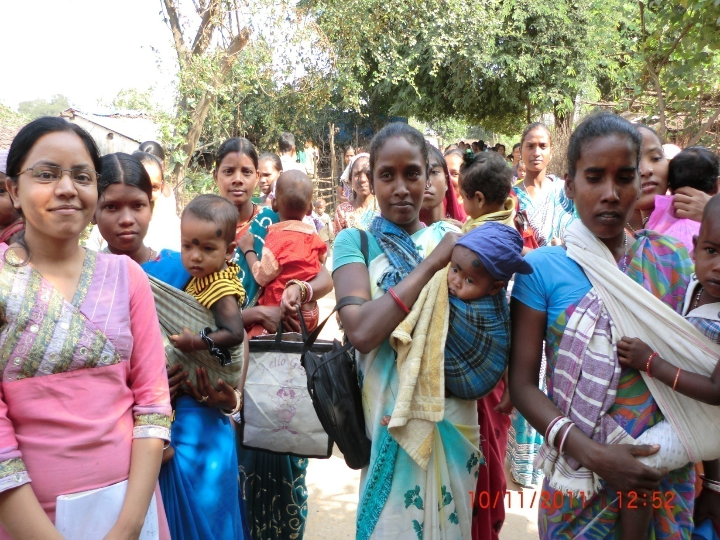
Improving Public Health through Innovation & Alliance

