Slide 1

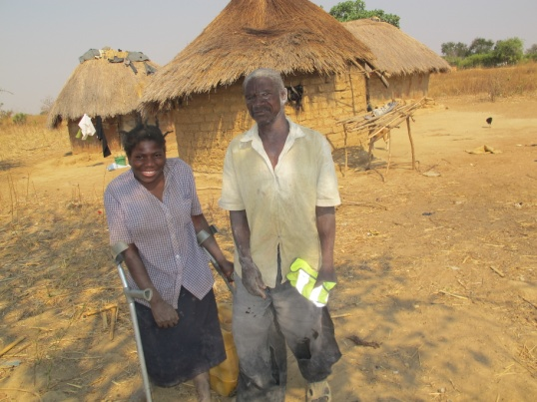





Undoing Inequity: water, sanitation and hygiene programmes that deliver for all in Uganda and Zambia
Presenter: Jane Wilbur, Equity, Inclusion & Rights Advisor, WaterAid
Collaborative partners: WaterAid, WEDC and LCD

Slide 2
Project overview
Research aim: to understand the barriers that persons who are disabled, older and people living with a chronic illness face when attempting to use standard WASH facilities in Zambia and Uganda.
Methods:
Gathering quantitative and qualitative evidence before WASH intervention
Developing a WASH intervention to address barriers faced
Monitoring and testing the intervention and approach
Assessing the impact and benefits for the target group

Slide 3
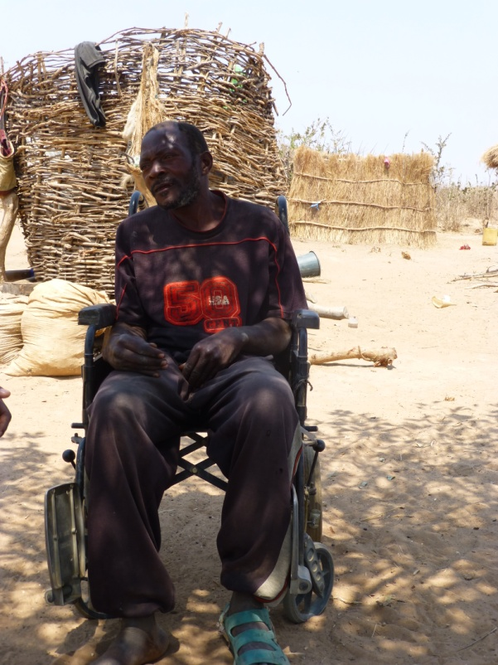
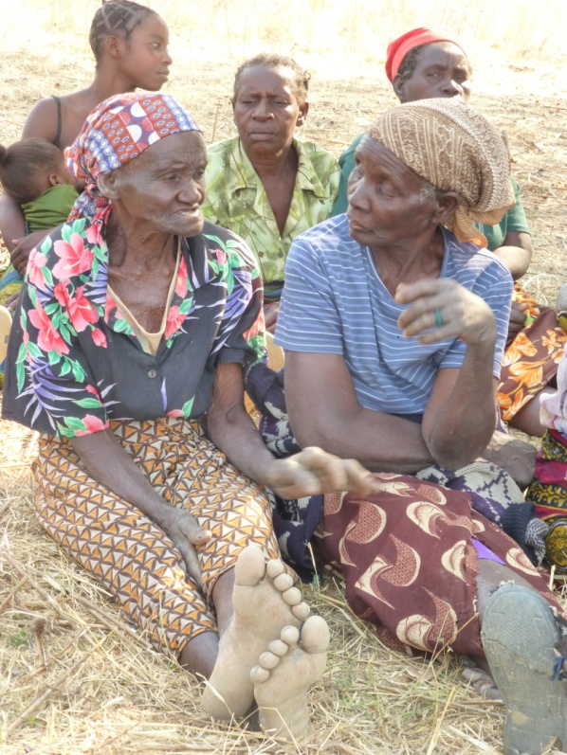
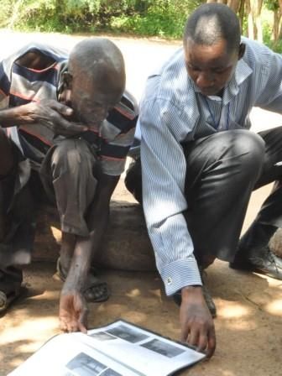
Influencing others: mainstreaming inclusive development
Loingnios Hachalambwela (Zambia), 55 years old
Members of the water user committee, Zambia
Mr Emalu (Uganda), looking at images of support rails

Slide 4
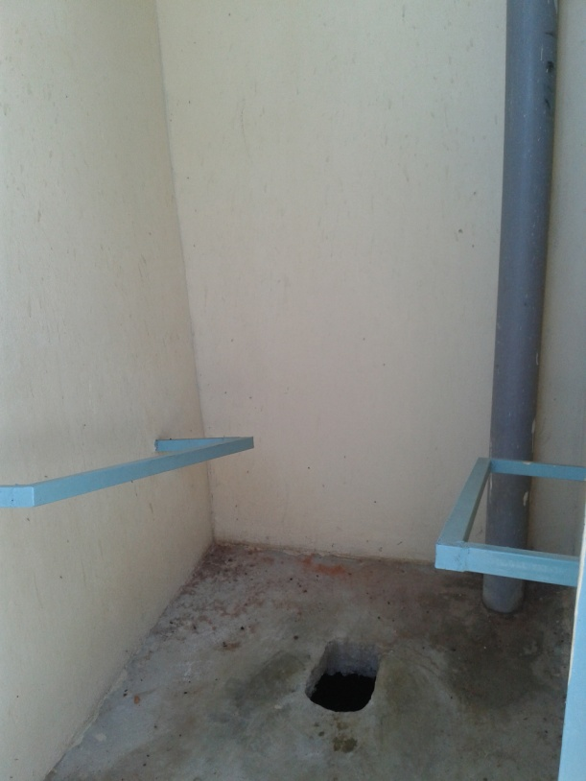
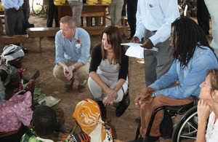
Influencing others: DFID’s commitment on school WASH
Left: Minister Lynne Featherstone and Ade Adepitan meeting disabled people benefiting from the project in Uganda.
Right: an accessible school toilet under construction in Uganda

Slide 5
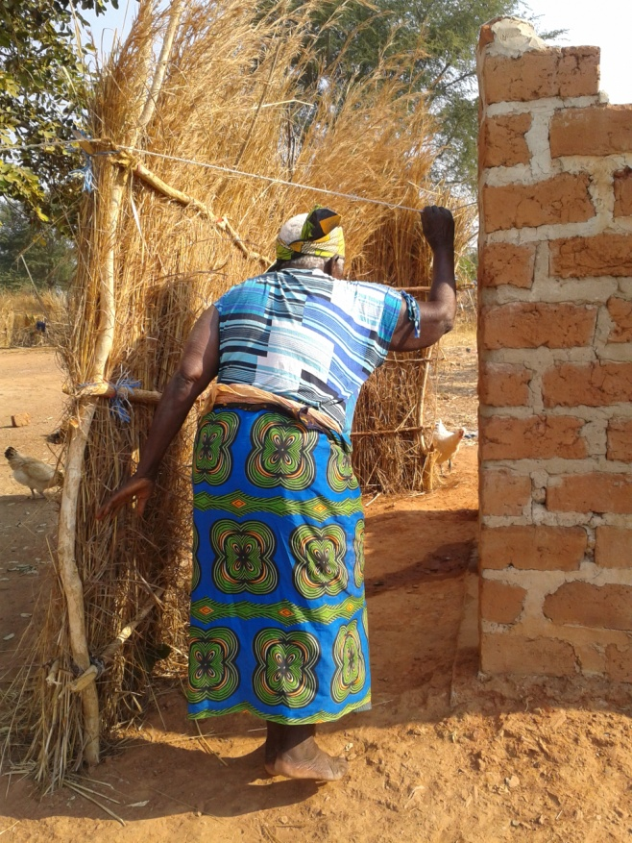
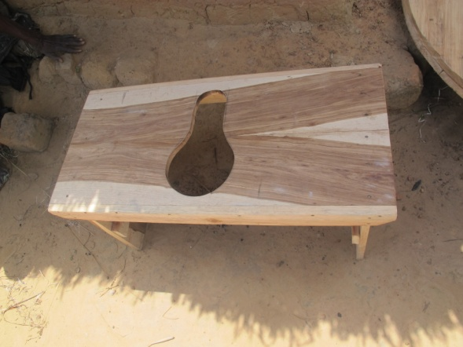
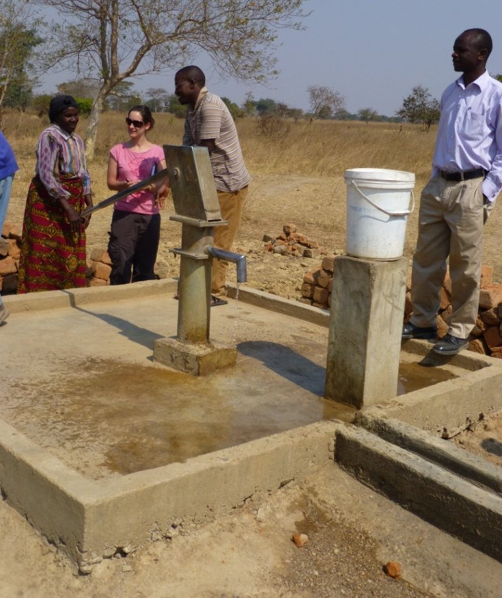
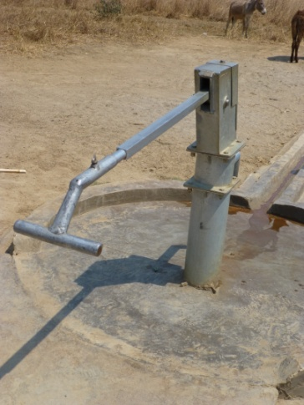
Influencing others: demonstrating viable low-cost solutions

Slide 6
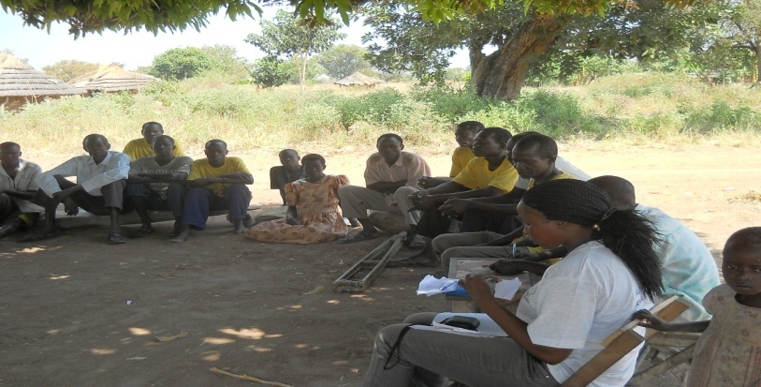
Influencing others: encouraging more effective data collection
Focus group discussions, Okuso village, Uganda

Slide 7
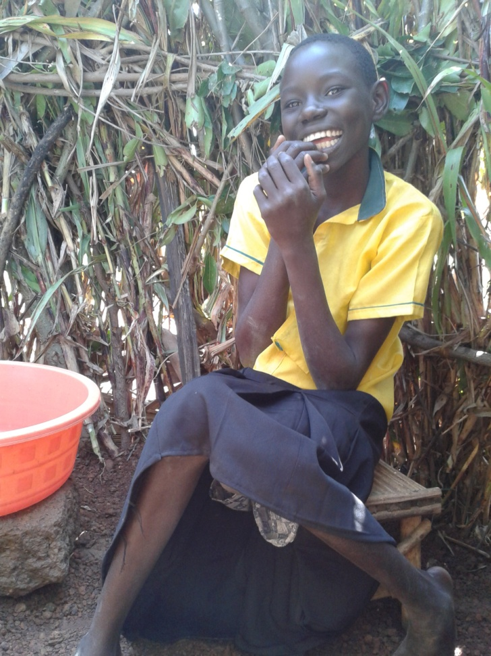
Thank you
Joyce Apiny (13 years old, physically disabled) in her accessible wash room

