Slide 1


Shared Sanitation and universal coverage; is it an improved form of sanitation, or not?
Jeroen Ensink
Environmental Health Group

Slide 2
WHO/ UNICEF JMP classification of sanitation
IMPROVED
UNIMPROVED
TECHNOLOGY
- Flush/Pour flush toilet
To piped sewerage system
To septic tank
To closed pit
- Ventilated improved pit latrine
- Composting toilet
- Pit latrine with slab
- Flush/Pour flush toilet
To elsewhere
- Pit latrine without slab
- Hanging toilet or hanging latrine
- No facilities
unimproved
SHARING STATUS
1 household
2 or more
households
Notes:
The JMP considers an improved facility as being capable of hygienically separating human excreta from human contact. Predominantly defined by sanitation technology; the simplest acceptable technology is a pit latrine with a slab.
(slide is animated click once to show sharing status)
The second criteria is sharing status; a facility should be accessed by no more than one household. The rationale for excluding shared facilities has been based upon the conviction that there is little incentive for an individual to keep a facility clean and well maintained. Other issues raised have been accessibility for all users due to location and when a fee is place etc.
For MDG monitoring purposes a rather simplistic improved versus unimproved scenario is reported, with all shared facilities being classified as unimproved - (second and third click shows shared being classified as unimproved) you can see from the diagram that shared but otherwise improved technologies fall into the unimproved category. So what is reported for MDG in the diagram is the unimproved red boxes and the improved green boxes.
(The JMP reports figures for all three categories highlighted, to enable a more comprehensive understanding of the status of global sanitation.)
Moving up the sanitation ladder (animated arrow comes across from right, showing direction of benefit) is assumed to result in an improvement in hygienic quality of the facility and consequently a reduction in health risks for users. However there is little evidence to substantiate this claim and what constitutes an hygienic latrine is not well described.

Slide 3
Sharing facilities
Estimate 760 million people rely on public and other shared sanitation (JMP 2013)
Globally, the number of users has increased by 425 million since 1990 – increasing from 6 per cent of the global population to 11 per cent in 20 years
Nearly a fifth of the population of sub-Saharan Africa and Eastern Asia reports using shared sanitation

Slide 4
Background
Historically, public and other “shared facilities”—those used by two or more households—are excluded from the definition of “improved sanitation” regardless of the service level.
According to the JMP, the reason stems from concerns that shared facilities are unacceptable, both in terms of cleanliness (toilets may not be hygienic and fully separate human waste from contact with users) and accessibility (facilities may not be available at night, or used by children, for instance).

Slide 5
Proposed Policy Change
JMP is considering a revision to is policy that would include shared sanitation as “improved”—and thus scored toward the post-MDG targets—if the facilities meet the required levels of service and are shared among no more than 5 families or 30 persons, whichever is fewer, where the users are known.
This proposed change is based on advice from an expert committee.
Minutes of Sanitation Task Force, December 2012.

Slide 6
Current Research on Shared Sanitation
Analysis of data from GEMS case-control study to assess odds of severe diarrhoea based on number of households sharing latrines (Baker et al.)
Analysis of JMP data to map geographic and demographic scope of shared sanitation (Heijnen et al.)
Analysis of JMP data to investigate association between shared sanitation and diarrhoea (Fuller et al.)
Systematic review of shared sanitation versus individual household latrines (Heijnen et al.)
Field investigation of shared sanitation versus individual household latrines in Indian slums (Heijnen et al.)

Slide 7
Geographic and Demographic Scope of Shared Sanitation
Extracted data on shared sanitation from the most recent national household surveys of 87 countries (DHS, MICS, LSMS)
Extracted data from the same surveys on selected covariates that may be associated with reliance on shared sanitation: urban/rural setting, wealth quintile, number of households sharing a latrine and the number of households without any latrine facilities.
We described and mapped the prevalence of shared sanitation by country and region and explored associations between the specified covariates and reliance on shared sanitation versus individual household latrines.

Slide 8
Geographical Scope of Shared Sanitation

Slide 9
Urban/Rural Prevalence of Shared Sanitation by Region

Slide 10
Systematic Review
Shared sanitation defined as any type of facilities intended for the containment of human faeces and used by more than one household, but excluded public facilities.
Health outcomes included diarrhoea, helminth infections, enteric fevers, other faecal-oral diseases, trachoma and adverse maternal or birth outcomes. Studies were included regardless of design, location, language or publication status.
Searched 19 electronic databases and hand-searched relevant conference proceedings, contacted researchers and organizations working in the field, and checked references from identified studies
Studies were assessed for methodological quality using the STROBE guidelines.

Slide 11
Results
Nineteen studies covering 19 countries met the review’s inclusion criteria.
Studies show a consistent pattern of increased risk of adverse health outcomes associated with shared sanitation compared to individual household latrines.
Diarrhoea
Helminth Infection
Adverse birth outcomes

Slide 12
Diarrhea (11 comparisons)

Slide 13
Helminth Infection (6 comparisons)
Number of persons per toilet was positively associated with Ascaris lumbricoides infection intensity (Tsushika 1995).
Sharing toilets with another family increased the risk of intestinal helminths (adjusted OR 1.95[95% CI 1.38-2.75]) and from protozoan parasites (adjusted OR 1.65 [95% CI 1.06-2.58]) (Mahfouz 1997)
Using a community latrine rather than a private latrine increased for S. stercoralis infection among adults (adjusted OR 2.72 [95% CI 1.57-4.72) and children (adjusted OR 2.43 [95% CI 1.35-4.38]), but not for those sharing with neighbors (Hall 1994)
Sharing latrine with other families and the absence of piped water inside the house were associated with a significantly higher intensity of infection for A. lumbricoides (p<0.001) and for T. trichiura (p<0.05) but not for S. mansoni (Curtale 1998)
Phiri et al. found no statistically significant risk associated with A. lumbricoides, hookworm, T. trichiura, or S. stercoralis infection and shared latrine facilities

Slide 14
Other Health Outcomes
Increase risk of poliomyelitis in an outbreak in Taiwan among those sharing toilets with other families (OR 4.0 [95% CI 1.9-8.3]) (Kim-Farley 1984).
Adverse birth outcomes associated with shared sanitation
Prematurity (adjusted OR 1.26 [95% CI 1.07-1.48]) and and low birth weight (adjusted OR 1.27 [95% CI 0.98-1.65]) (Olusana 2010)
Perinatal death among women, antepartum fetal deaths (adjusted OR 1.62 [95% CI 1.28-2.03]) and perinatal death (adjusted OR 1.41 [95% CI 1.21-1.64]) (Golding 1994)
hospital admissions for children (Munoz 1992)
No increased risk of trachoma from shared latrines (adjusted OR 0.95 [95% CI 0.55-1.67]) (Montgomery 2010)

Slide 15
Conclusions
A large and growing population relies on shared sanitation, particularly in urban settings in Africa and Asia
Evidence to date does not support a change of existing policy of excluding shared sanitation from the definition of improved sanitation used in international monitoring and targets.
However, such evidence is limited, does not adequately address likely confounding, and does not identify potentially important distinctions among types of shared facilities.
Further research is necessary to determine the circumstances, if any, under which shared sanitation can offer a safe, appropriate and acceptable alternative to individual household latrines.

Slide 16
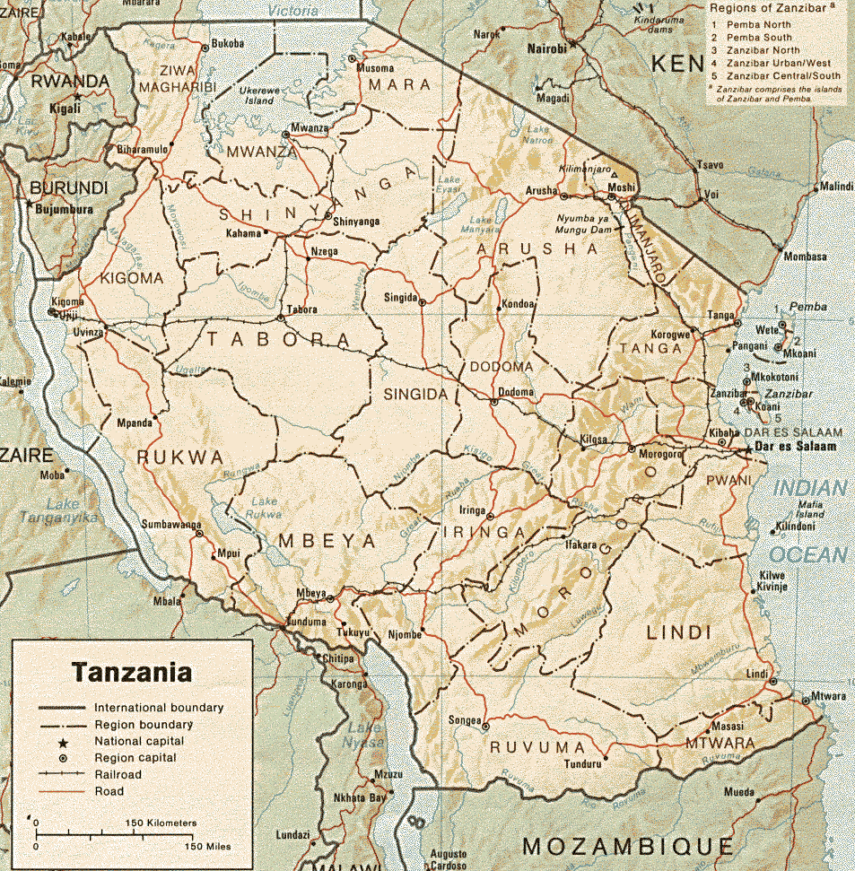
Hygiene along the sanitation ladder
Selection of >350 latrines
Divided over different groups
Rural vs Urban
Improved vs Unimproved
Shared vs Family latrine
Different technology
Impact of seasonality
Comparative sample within the household
Different transmission routes
Hand contact point sampled for presence and concentration of E. coli
Soil samples analysed for helminths
Fly catches within latrines
Notes:
Aimed to distinguish between those latrines that were preventing human contact from faecal pathogens. Identified three possible routes of transmission via hands, feet and flies.
E.Coli:
Surface samples were taken from points of hand contact such as door handles, or as pictured from an entrance curtains, and side walls (and in order to place these in an environmental context also from similar household surfaces).
E.Coli was selected as it is exclusively faecal in origin. E.Coli colonies are relatively simple to identify and are more proliferous than many more dangerous pathogens, though they react to environmental condition in a similar way to these pathogens, making them an ideal indicator of faecal contamination and the presence of other more hazardous intestinal parasites and pathogens.
Helminths;
Surface soil samples were taken from around the drop hole at points it was thought probable that users would position their feet, pictured is our field assisstant Bernard, who helped with sample collection as well as conducting questionnaires. Samples were also taken from around the household compound.
Hookworm, ascaris and Trichuris were considered together. They are a good indicator of environmental contamination as; they do not multiply outside of the human host, they persist in the environment for several years and can be easily identified.
Flies:
Sticky fly traps were hung from the roof of each latrine for 24 hours.
Whilst we have collected data on the total number of flies, only those results for blow and house flies were considered for analysis as they are known mechanical vectors of faecal pathogens; in experimental conditions flies have transmitted viruses, bacteria, protozoa and helminth eggs. What we are actually measuring is the number of flies visiting the facility.
Other things:
Participants are required to answer a questionnaire, regarding use and maintenance. A latrine assessment to gather information on the condition of the facility including materials used for construction etc.

Slide 17
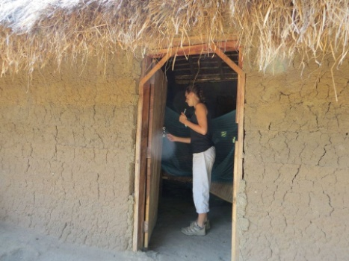
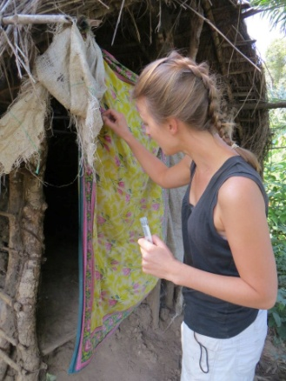
Hand contact (E. coli)

Slide 18
Latrine characteristics

Slide 19
E. coli at point of hand contact

Slide 20
Risk factors
E. coli
Higher levels of contamination in dry season (10 vs 37 E. coli/100 ml)
The higher the number of users the cleaner the facility
Mutivariate: presence of a slab, and season significant
Helminths
No correlation between type of latrine and concentrations in courtyard
60% of latrines without a slab positive, 100% of latrines with a cracked slab
Flies
Concentrations low
Urban latrines produce more flies and higher levels of sharing result in more fly
Absence of a roof a key risk factor

Slide 21
Conclusions
Pit latrines without a slab can pose a risk for hookworm infection
Need to come-up with solutions to improve the simple pit latrine (without a slab)
Use and management seem more important in hygiene of a latrine than technology alone
Shared latrines should be included as an improved form of sanitation in new SDGs

Slide 22


Acknowledgement

