Slide 1
Research In Private Sector Participation In The Delivery Of Sanitation And Hygiene Services (RESEARCH/SHARE/MALAWI/2013/1) for The Government of The Republic of Malawi Ministry of Water Development and Irrigation
Dr. Rochelle H. Holm, Principle Investigator
Mzuzu University Centre of Excellence in Water and Sanitation
26 June 2014

Slide 2
Overview
Project Objectives
Method
Results and Discussion
Conclusion
Notes:
In this presentation I will cover
Project Objectives
Method
Results and Discussion
Conclusion

Slide 3
Project Objectives
The project is funded by the UK Department for International Development through the SHARE Research Consortium. The project will specifically address the following components:
Identification of private sector institutions and their roles
Identification of the potential opportunities, barriers and threats within the sector in taking up sanitation as a business
Identification of funding mechanisms for private sector participation and provision of household sanitation facilities, which among others would include creation of a Sanitation Fund
Identification of initiatives that the district councils are taking to encourage the medium to high-scale entrepreneurs to take up sanitation as a business as stipulated in the National Sanitation Policy
Identification of the reasons why lending institutions are not willing to provide financial services
Notes:
In this presentation I will cover findings from the first two objectives.

Slide 4
Area of Investigation – Nkhata Bay District
Notes:
The area of investigation is Nkhata Bay District
The total population for the district is 215,789 and mostly rural. The most common method of human waste disposal in is via a non-improved sanitation facility, with 95% of households using a traditional pit latrine. The National Water and Sanitation Policies give District Councils a number of institutional roles and responsibilities for implementation of sanitation and hygiene activities in the district.
District wide unemployment for women is reported at 28.5% and men is at 10.2%. Yet, Fishing and fish farming within the district are a source of income and food for over 90% of the population. This poses a unique barrier to increasing demand for household or community sanitation facilities, as much of the population spends up to 12 hours a day on the lake where open defecation is convenient.
Rural sanitation within the District is being addressed by the district council, non-governmental organizations, a local environmental club, grass roots women’s groups and entrepreneurs.

Slide 5
Method
Interviews with key informant questionnaires and in-depth interviews, focus group discussions, household surveys, and non-participant observation.
Data collection tools received ethical clearance from the National Commission for Science and Technology.
Trained research assistants and supervisors were employed for data collection.
Training sessions, including mock interviews, were conducted prior to field collection with enumerators from Mzuzu University.
Notes:
The project used a number of data collection methods, including key informant questionnaires and in-depth interviews, focus group discussions, and non-participant observation. Data collection tools received ethical clearance from the National Commission for Science and Technology.
Purposive sampling was based on involvement and participation in the delivery of sanitation and hygiene services at national and district level. Interviews with sanitation entrepreneurs were also carried out to better understand why they went into the business and current constraints to scaling-up.
Trained research assistants and supervisors were employed for data collection.
Training sessions, including mock interviews, were conducted prior to field collection with enumerators from Mzuzu University.

Slide 6
Results and Discussion
Examples of sanitation as a business in Malawi
UNICEF Malawi
Malawi Homeless Federation Nkhata Bay Chapter (MHPF)
“People want these latrines for free because they are used to getting free things from organizations”
Notes:
The study provides a detailed description of district-level business activities in the sanitation sector. Here, I will present two case studies of particular interest. First, the work carried out by UNICEF Malawi to enhance private sector involvement in sanitation. In 2013, UNICEF Malawi collaborated with Tools for Enterprise & Education Consultants (TEECs) held a two-day technical training session for local entrepreneurs on a new low-cost latrine design known as a corbelled latrine. A total of 32 applications were received, and 18 were selected to participate.
Six months following the technical training, the participants were surveyed about their current business success and constraints. Of the 18 original participants, 11 could be reached for follow-up. Nine of the 11 entrepreneurs reportedly had household customers purchasing their products. The occupation of these customers - mostly farmers - suggests some people are willing to pay for improved sanitation in rural areas. However, while households communicated they want improved latrines, the limitations of further build-up of private sector sanitation in the area is seen in the comment from one entrepreneur: “People want these latrines for free because they are used to getting free things from organizations”. Nonetheless, the same entrepreneur reports on one adaptation strategy: “Because people are not willing to pay money to purchase these corbelled latrines, I ask them to pay anything that is equivalent to the price e.g. a goat.” Interestingly, of the nine entrepreneurs within this group currently selling products successfully, currently none use loans for the business and customers do not currently use loans for purchase of products because there are no funds available for either to borrow for investment.

Slide 7
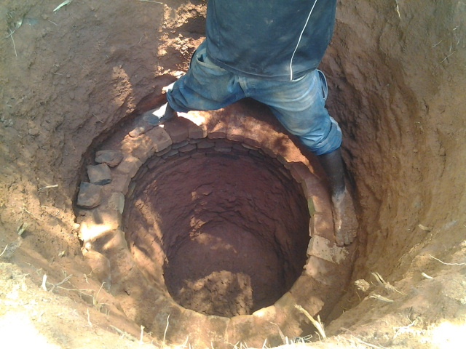
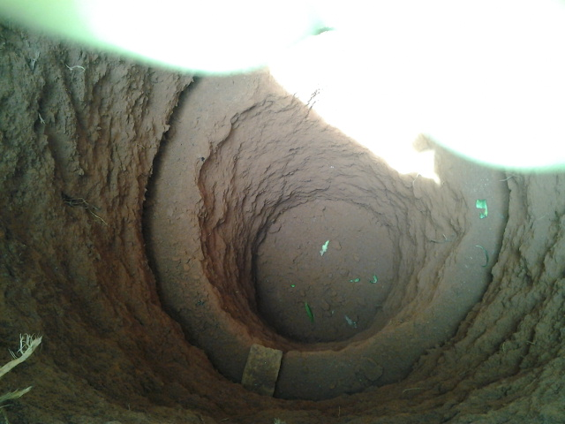
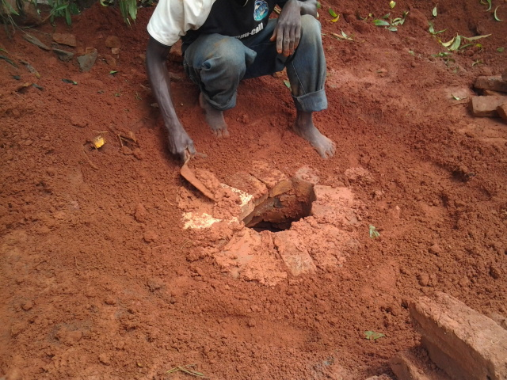
Low cost sanitation – Corbelled Latrine
Notes:
There was great variability in the prices the entrepreneurs were charging for the same low-cost sanitation product within the district. Toilets were being sold for as little as MK3,000 if the customer supplied materials (bricks) and up to MK30,000 inclusive of all materials and labor.
This great variability in prices the entrepreneurs are charging tells of a true free market operating by the entrepreneurs. It could be that some entrepreneurs are working in areas where higher profit margins are possible. This requires further research, but it is promising that some customers are willing to invest in improved sanitation in this rural area.

Slide 8
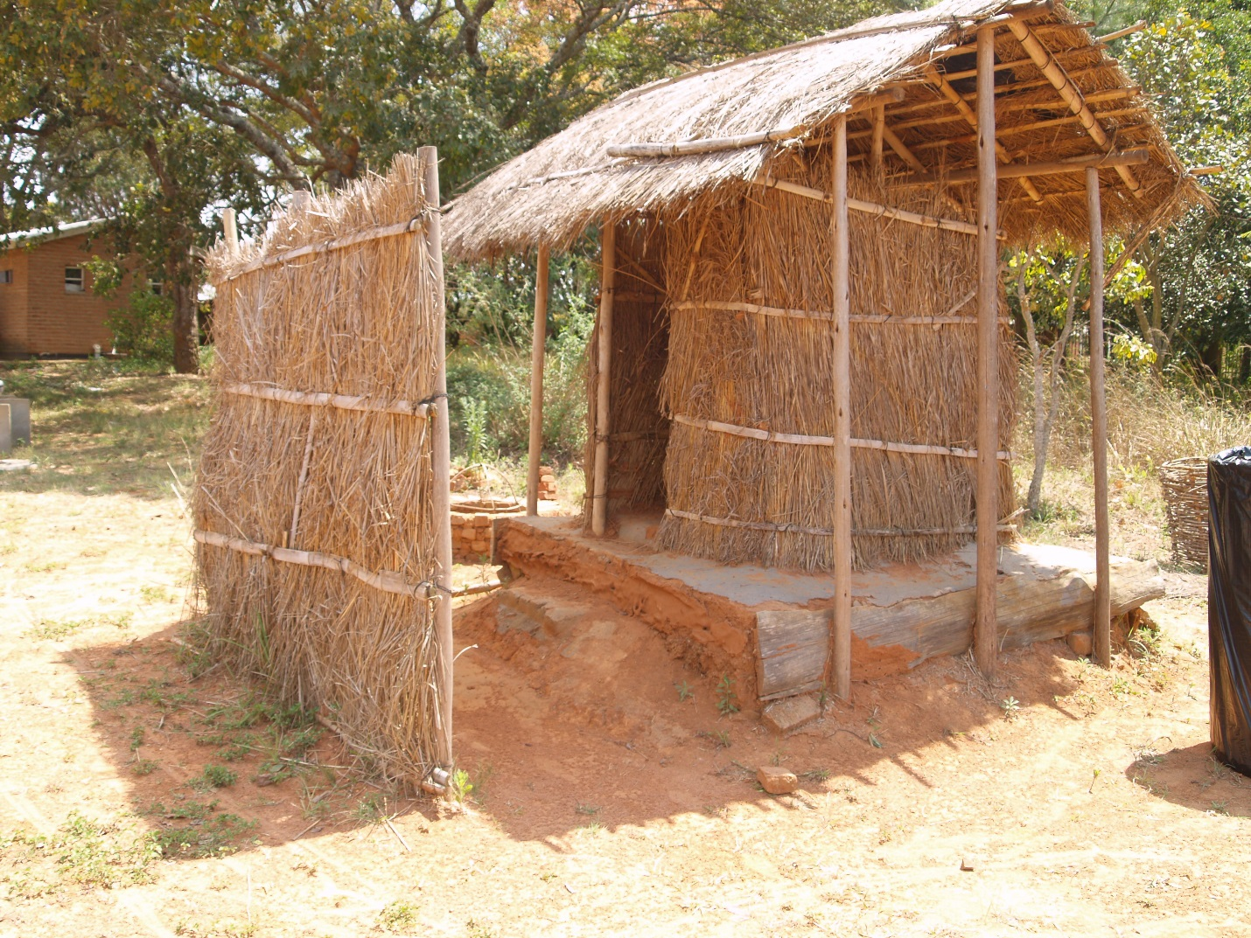
Notes:
This is an example finished corbelled latrine.

Slide 9
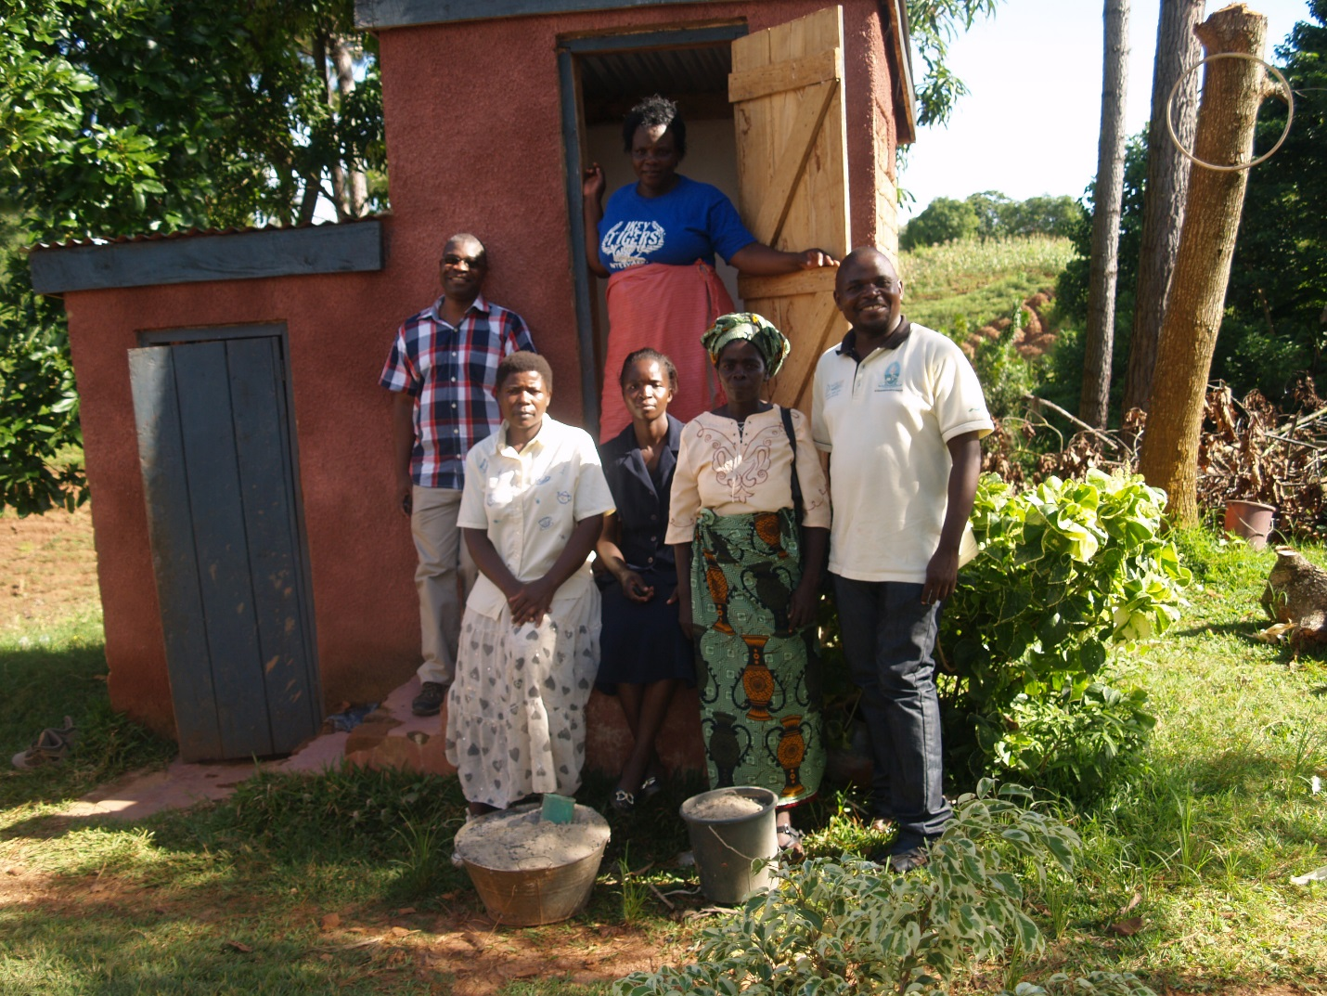
Malawi Homeless People’s Federation (MHPF)
Notes:
MHPF has so far constructed 50 Skyloo latrines, a type of latrine which composts human feces, in households using a sanitation fund, which they get from the Centre for Community Organisation and Development. Currently a household contributes MK3,500 while MHPF matches this with a material loan of MK35,000, payable within two years with an interest rate of 2% per month. The MHPF does not get paid for its services, which are voluntary.
MHPF has found a number of opportunities in Nkhata Bay that make the sanitation market an appealing one to invest in. There is a very high demand for ecosan latrines around the city center, and there is a readily available market from individuals and institutions that use the manure for landscaping and urban agriculture. Manure is being sold at MK2500/50 kg bag to people within Nkhata Bay and also farmers and landscapers from Mzuzu. Furthermore, MHPF is well supported by the District Council, who has provided a place for the construction of a paying toilet at the market place, and has a good working relationship with the community. MHPF also has a good working relationship with CCODE, who provides training and funding, and with local builders and plumbers, who are involved in the construction of toilets.

Slide 10
Conclusion - Opportunities
Low cost technologies suitable for rural areas.
Improved sanitation for public facilities.
Pit latrine emptying.
Tourist facilities.
Entrepreneurs.
High population growth rates.
Partners.
Monitoring and evaluation.
Notes:
There are also a number of challenges to a successful business model in the sanitation sector. While there is a good market, this market does not exist within the city center as there are not many gardens, and thus clients, within the city center since land is rocky and sandy in most parts.
Low cost technologies suitable for rural areas. There has not been much done on innovative, durable low-cost latrines. The status quo is typically used, and there is an opportunity for additional innovative improved latrine designs.
Improved sanitation for public facilities. Currently MHPF is building toilets to meet the needs of the Nkhata Bay market area. Yet, the hospital remains with a large problem with sanitation.
Pit latrine emptying. There are no service providers for emptying septic tanks in Nkhata Bay.
Tourist facilities. Nkhata Bay is a tourist attraction center, which increases demand for sanitation services. There are a number of hotels and lodges within the district. There is scope for these facilities to hire private sector sanitation businesses to meet their sanitation and gardening/landscaping needs, as well as generating added revenue through the sale of surplus manure. Mayoka Village in Nkhata Bay has eco-san latrines and is able to sell the harvested manure.
Entrepreneurs. There is still space within the sanitation market for emerging sanitation business and motivated entrepreneurs who are willing to invest in sanitation and hygiene promotion in Nkhata Bay District.
High population growth rates. This leads to high volumes of waste production, which could be recycled and provide items of high value such as compost and hu-manure for sale or agricultural use.
Partners. Existence of motivated development partners who are willing to promote sanitation and hygiene in Nkhata Bay District.
Monitoring and evaluation. A certification program for private sector sanitation services was recommended to be initiated within the District to allow monitoring and evaluation of private sector within the district.

Slide 11
Conclusion - Barriers
Willingness to pay.
Culture.
Physical environment.
Political interference.
Funding.
Collaboration.
Notes:
Barriers
Willingness to pay. Unwillingness to pay toilet fees leading to frustrated would-be entrepreneurs who are otherwise willing to invest in sanitation services.
Culture. Cultural barriers, which retard adoption of sustainable sanitation solutions such as eco-san or new low-cost latrine designs, which may need community sensitization for further scale-up by the private sector.
Physical environment. Existence of thick forests which promotes open defecation and non-willingness of some residents to construct own latrines. Also, latrines easily collapse since land is rocky and sandy in most parts of Nkhata Bay.
Political interference. Political interference when slow in allocating land to would be entrepreneurs.
Funding. Lack of a sanitation fund for sanitation and hygiene promotion for both build-up of business and for customers.
Collaboration. Empowering rural communities with good sanitation and hygiene practices through Community-Led Total Sanitation and rural sanitation marketing needs to be a united approach by NGOs, local clubs, grass roots groups and entrepreneurs as led by the District.

Slide 12
Conclusion - Threats
Population growth.
Lack of financing mechanisms.
Limited research.
Available national and district policies and structures.
Notes:
Threats
Population growth. Anticipated land scarcity for latrine construction due to the increasing population growth rates.
Lack of financing mechanisms. Very few financing and micro-finance institutions supporting sanitation entrepreneurs in the district.
Limited research. Few sanitation marketing researchers to help sanitation sector professionals better understand rural consumer’s constraints and aspirations to further build the sector.
Available national and district policies and structures. National Sanitation Policy doesn’t at present include language supporting public-private partnerships.

Slide 13
Conclusion
There are significantly more opportunities than there are barriers or threats for entrepreneurs to take up sanitation services as a business.
With appropriate training and funding it is possible to bring in new entrepreneurs to provide sanitation services in a rural setting without service subsidy.
The barriers that have been identified can be overcome with improved training for potential entrepreneurs, as well as the creation of a sanitation fund to enable further scale-up of private sector sanitation services in the District.
Notes:
The findings from this research have demonstrated that there are significantly more opportunities than there are barriers or threats for entrepreneurs to take up sanitation services as a business. With appropriate training and funding it is possible to bring in new entrepreneurs to provide sanitation services in a rural setting without service subsidy. Furthermore, the barriers that have been identified can be overcome with improved training for potential entrepreneurs, as well as the creation of a sanitation fund to enable further scale-up of private sector sanitation services in the District.
While this research has answered some important questions regarding the status quo of private sector involvement in sanitation services, additional research is needed to enable solutions to the barriers and threats highlighted. This will be addressed in the research questions addressed as part of the overarching project on “Private Sector Participation in the Delivery of Sanitation and Hygiene Services” (see page 1).

Slide 14
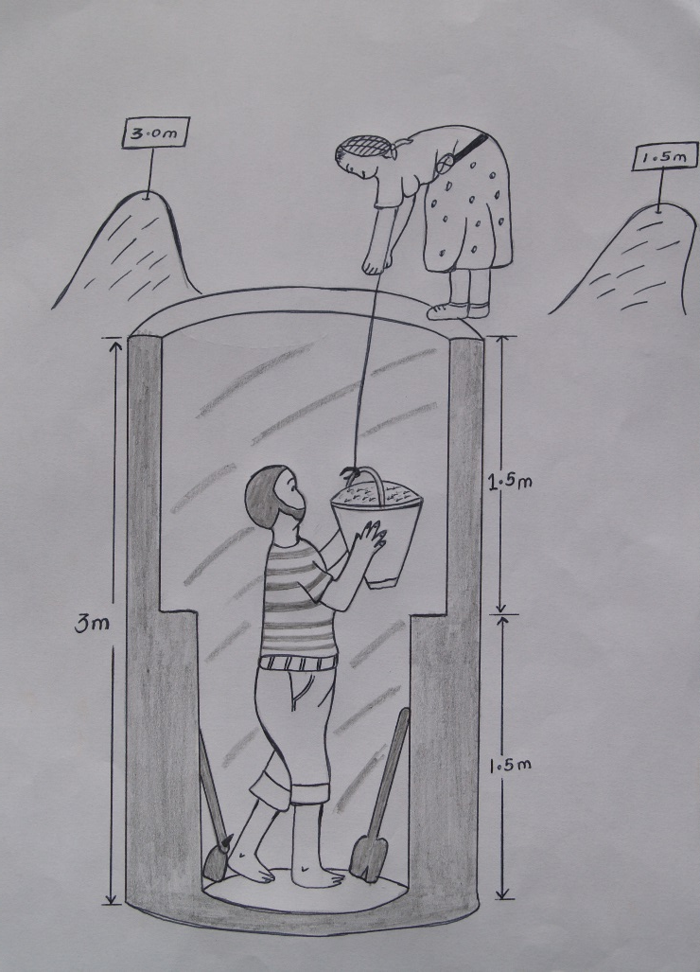
Thank you

Slide 15
Questions
Rochelle Holm, Ph.D., PMP Mzuzu University Centre of Excellence in Water and Sanitation and SMART Centre Manager P/Bag 201, Mzuzu 2, Malawi Cell: +265992159079 or +265882725730

