Slide 1







Sanitation markets
The role of microfinance to support access to sanitation
Sophie Trémolet, DFID, 19th November

Slide 2
Why focus on microfinance?
Demand from practitioners
How can access to sanitation be increased?
Typical sanitation support programme focuses on software support but with no or limited support for access to finance
Gap in research: SHARE research consortium “Sanitation markets pathfinder”
Examines why sanitation markets work or fail alongside value chain
RCT finding in Indonesia: “access to credit” is key limiting factor

Slide 3
SHARE research activities
Call A: Initial mapping
Is there demand and supply of sanitation microfinance services
Who are key players in the sector?
What do we currently know?
Call B: Case study research
India: evaluate existing experiences
Tanzania: experience review and evaluation of market potential
Tanzania research fund
Action research with selected institutions

Slide 4
Key findings
Limited development overall but difficult to track due to lack of data
Growing market in India
146,000 sanitation loans identified enabling 730,000 people to build toilets
Very high repayment rates (98%)
Most successful if developed by existing MFIs
Some NGOs successful at developing microfinance branch (Gramalaya / Guardian) with support from water.org or Dutch funding (FINISH project)

Slide 5
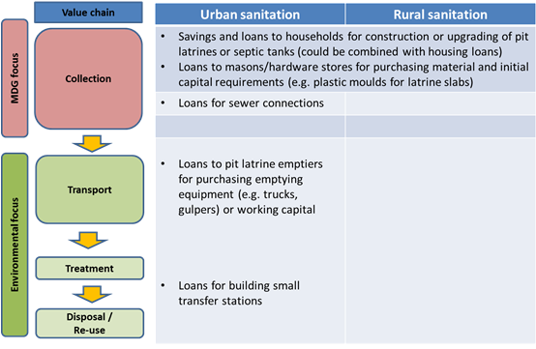
Market potential (e.g. in Tanzania)
But MFIs / commercial banks not familiar with sanitation markets so not willing to take the risk

Slide 6
Research into use
Donors have a key role to play
Incorporate microfinance as part of broader sanitation programmes
Channel support to MFIs (or NGOs)
Market evaluation, product and system development
Initial capital for revolving funds, potentially combined with subsidies to reduce initial borrowing costs
Interest for donors
Improved targeting of limited subsidies
Higher leveraging of their investment

Slide 7
For more information
See:
http://www.shareresearch.org/Page/Detail/markets
http://www.tremolet.com/focus-area/266 (sanitation financing)

