Slide 1




Women, WASH and Health in Rural Pune District
Identifying stress and unmet needs
Prof. Dr. Mitchell Weiss Dr. Sanjay Juvekar
Swiss TPH KEM Hospital Research Centre
Basel, Switzerland Pune, India
International Sanitation and Gender Workshop
Park Hotel, New Delhi, India
9-10 December 2013

Slide 2
Too few toilets for too many people
Indicated failure to apply expertise
Household coverage with cell phones 59% compared with 47% with toilets (Census 2011)
Many schools fail to comply with requirements for toilets
Medical facilities lack adequate sanitation facilities
Mission Mars landing: contradiction between high-tech capacity and limited attention to basic needs, incl. sanitation

Slide 3
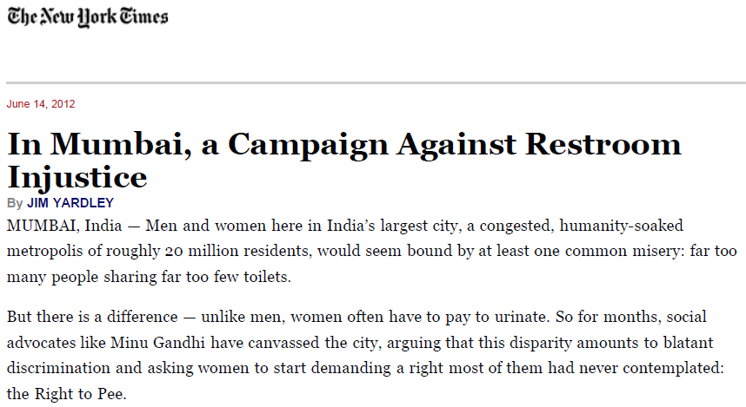
Well-known and widely reported

Slide 4

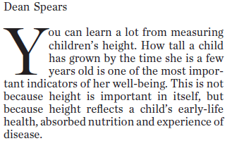
The Hindu, Chennai,
14 Mar 2013.
See also,
Chambers R and von Medeazza G. Sanitation and stunting in India: undernutrition’s blind spot. Econ Pol Weekly 22 Jun 2013.

Slide 5
Health and Gender-related impact
Health
Diarrheal diseases
Stunting
Psychosocial stress from limited (access to) facilities
Gender-related
Vulnerability to violence and victimization
Cultural meaning and social restrictions of menstruation
Burden of culturally mandated modesty

Slide 6
Coping
Problematic
Avoiding hydration and solid foods
Acceptance of unacceptable status quo
Constructive
Clarify the nature and extent of community-perceived burden
Replace victim blame and shame with social change
Advocacy and support

Slide 7
Request for Proposals : The effects of poor sanitation on women and girls in India
Response
Collaboration between:
KEM Hospital Research Centre Pune’s field site Vadu Rural Health Program in India (KEMHRC)
and
Swiss Tropical and Public Health Institute, Basel, Switzerland (Swiss TPH)

Slide 8
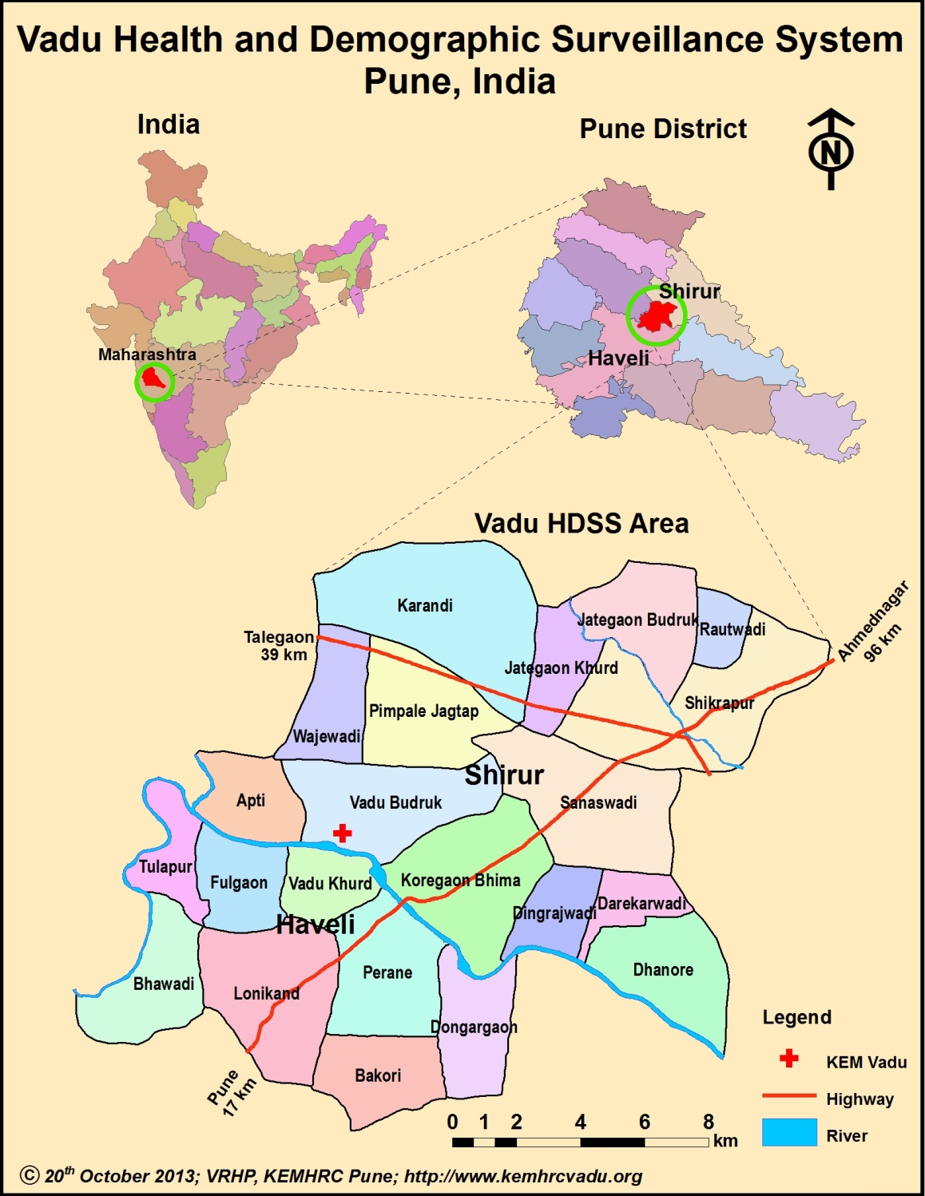

Slide 9
Conceptual framework of research plan
Basic
needs
Defecation-urination
Nutrition-hydration
Facilities and resources
Toilets and fields
Water and food
Use-mitigating factors
Personal prior experience
Family and community experience and expectations
Menstruation
Absorbent materials
Social and cultural values
Practice
WASH-related behaviour
Indicated adjustments to dietary and fluid intake
Menstrual hygiene
Health impact
Self-perceived health problems or benefits of reported practice
Psychosocial effects: personal, family and community

Slide 10
Aims
Identify sources of psychosocial stress with reference to personal experience, reported accounts and perceived vulnerability to violence that affect access and use of various types of sanitation facilities and open defecation.
Identify women’s preferences, priorities, practices and perceived needs regarding menstrual hygiene, distinguishing preferred and available options, assessing the stress imposed by social expectations and cultural values and clarifying perceived effects on women’s health.
Assess the level of stress, priority and self-perceived effects of limited access to water and sanitary facilities, and the extent to which such concerns may lead to coping strategies that involve limiting intake of food and liquids.
Determine the availability, functionality and perceived adequacy of sanitary infrastructure in local health facilities, with particular attention to those facilities providing prenatal and obstetric care. Clarify whether these concerns influence the preference and use of accessible health facilities.

Slide 11
Methods
No. | Research Method | Sample
1. | Quantitative Research
 | Survey questionnaire | 150 adolescents (13-17 years) 150 adults (18-45 years)
 | Health facility infrastructure assessment | 12 health facilities in the study area (public as well as private)
2. | Qualitative Research
 | a. Focus group discussions | 8 to 12 Focus Group Discussions(2 each of adolescents, young women, older women and seasonal migrant women)
 | b. Key informant interview | 10 Key Informants Interview (2 each of Members of Gram Panchayat, Members of Panchayat Samiti, School Teachers, Health Professionals like ASHA, ANM and Medical officers).
 | c. Free listing | 20 adolescents (13-17 years) 20 adults (18-45 years)

Slide 12
Data analysis: qualitative
Collected through FGDs, KIIs and Free listing:
Transcription and translation of recordings
First-level coding
Analysis using standard qualitative analysis approaches and programmes (e.g. MAXQDA or Altas.ti and Anthropac)
Analysis of the free listing exercise with reference to the cultural domains they refer to, including WASH-related and menstruation-related issues

Slide 13
Data analysis: quantitative
Collected through community survey and WASH infrastructure in health facilities survey
Summarizing data with standard descriptive statistical measures such as means, median and standard deviations.
Statistically significant associations using standard statistical tests such as Pearson’s chi-square test and t-tests, as appropriate.
Multivariate models to identify the most important determinants of certain outcomes while considering known and suspected explanatory and confounding variables.
Using STATA statistical package

Slide 14
Work done so far
Study Inception workshop in September 2013 to finalize the protocol and data collection tools
Ethics committee approval obtained
  KEMHRC and SwissTPH
Tool field pretesting in November 2013
Training of field team in end of November 2013
Field data collection started 2nd December 2013.

Slide 15
Preliminary experiences
Observations:
Migrants and local residents have differential access to facilities.
Snake bite is reported in response to questions about violence.
Generally people do not report violence (could be reality / could be shame)

Slide 16
Quotes: Pretesting- FGD
“We observe the restrictions during menstruation and we would want the next generation to observe the same”.
“The Goddess is very strict, hence it is important that restrictions are observed during menstruation”
“We are migrants, so they (the politicians) think that we need only shelter and water but no one thinks about toilets”.
“We have everything (toilet facility) at home but at public places we need toilets”.

Slide 17
Quotes: Pretesting- KII
(Local body leader)
“In our village things like this (violence) do not take place but I have heard such incidences from outside”.
“Funds are insufficient for maintaining the toilets at schools and public places”.

Slide 18
Expected impact
A) Locally (in Vadu):
Documentation of stress and unmet needs related to WASH
Evidence to inform policy, public investments and programmes.
B) Nationally (in the framework of the larger SHARE and WSSCC objectives):
Contribution to national data on demand for WASH and psycho-social effects of current deficits.
Baseline to benchmark impact of future sanitation and violence-prevention programs.
Identification of factors hindering success of existing programs (focus on WASH, menstrual hygiene, utilization of health care facilities and school attendance).
One-page factsheet and other materials focusing on safe and gender sensitive WASH solutions for scientific community, local government bodies as well as the study population

Slide 20
Intersectoral collaboration
Social
Engineering
Medical
Development

Slide 21
Vulnerabilities
Gender
Physical disability and special needs
Stage of life
Poverty and capacity to cope

Slide 22
Interpreting limited opportunities for sanitation
Cultural pollution
Blame victim
Change social system
Morality and purity
Social basis of burden
Public health and human rights

Slide 23
Motivation of research and how we use evidence
Advocacy
  Elaborate problems and need for solutions
  Budget
  Specific programme strategy
Guidance
  Analysis of problems and ways to mitigate
  Design of intersectoral solution (e.g., facilities, policies)
  Specific strategies: implementation and training

Slide 24
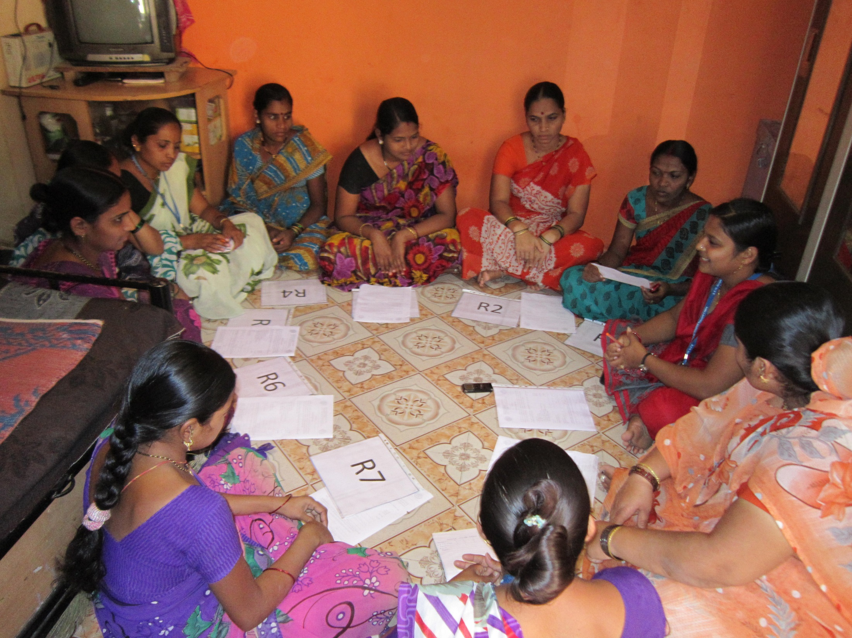
Thank you

